Slide 1
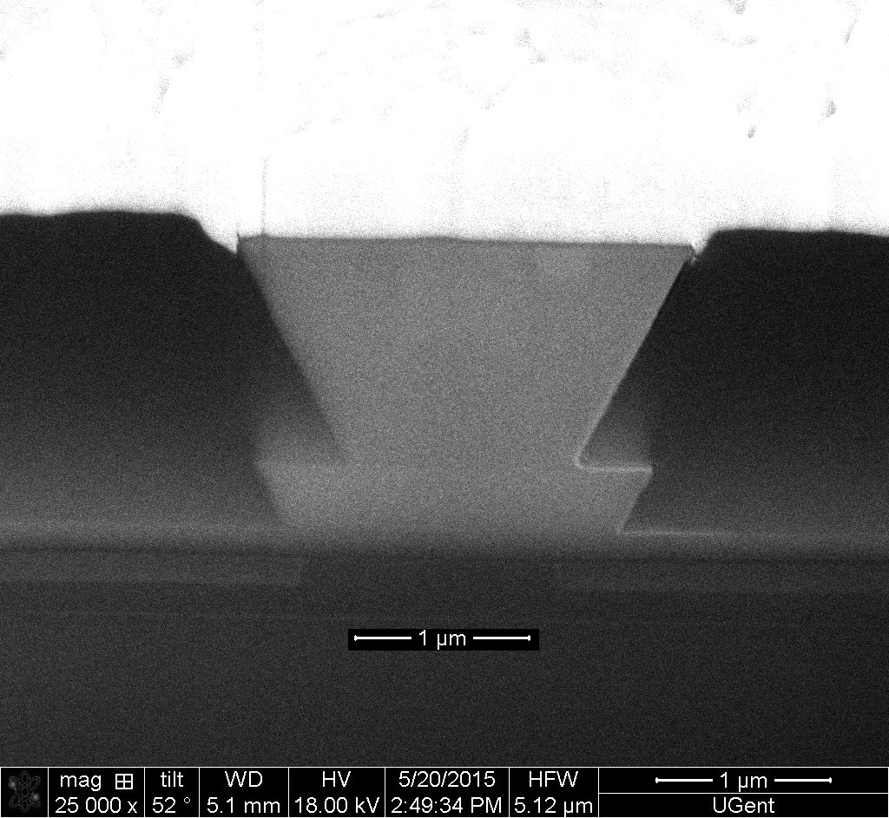
(a)
1 um Au
40 nmTi
(b)
0.1 μm p-InGaAs
1.5 μm p-InP
150 nm SCH
187 nm MQW
100 nm SCH
150 nm n-InP
380 nm Si
2 μm SiO₂

Slide 2
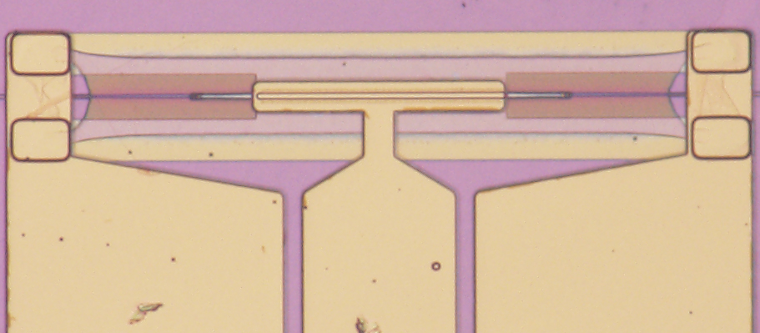
(a)
G
(b)
Ti/Au
G
S
p-InGaAs
p-InP
SCH
MQW
SCH
S
bi-level taper coupler
G
n-InP
Si
G
SiO2
50 μm

Slide 3
(a)
(b)
1 um Au
40 nmTi
0.1 μm p-InGaAs
G
1.5 μm p-InP
150 nm SCH
S
187 nm MQW
100 nm SCH
150 nm n-InP
G
380 nm Si
2 μm SiO₂
50 μm

Slide 4
(a)
G
(b)
Ti/Au
G
S
p-InGaAs
p-InP
SCH
MQW
SCH
S
bi-level taper coupler
G
n-InP
Si
G
SiO2
50 μm

Slide 5
(b)
p-InGaAs
p-InP
SCH
MQW
SCH
Si
n-InP
Ti/Au
G
S
50 μm
G
SiO2

Slide 6

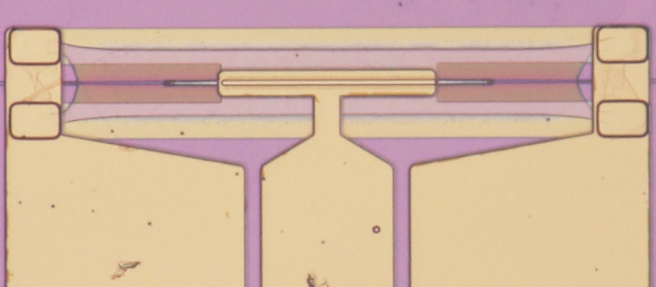
(a)
(b)
(c)
(d)

Slide 7
(a)
(b)
(c)
(d)

Slide 8
(a)
(b)
p-InGaAs
p-InP
SCH
MQW
SCH
n-InP
Si
SiO₂

Slide 10
(a)
(b)
Continuum transitions absorption
Exiton transitions absorption

Slide 11
(a)
Continuum transitions absorption
Exciton transitions absorption
(b)

Slide 12
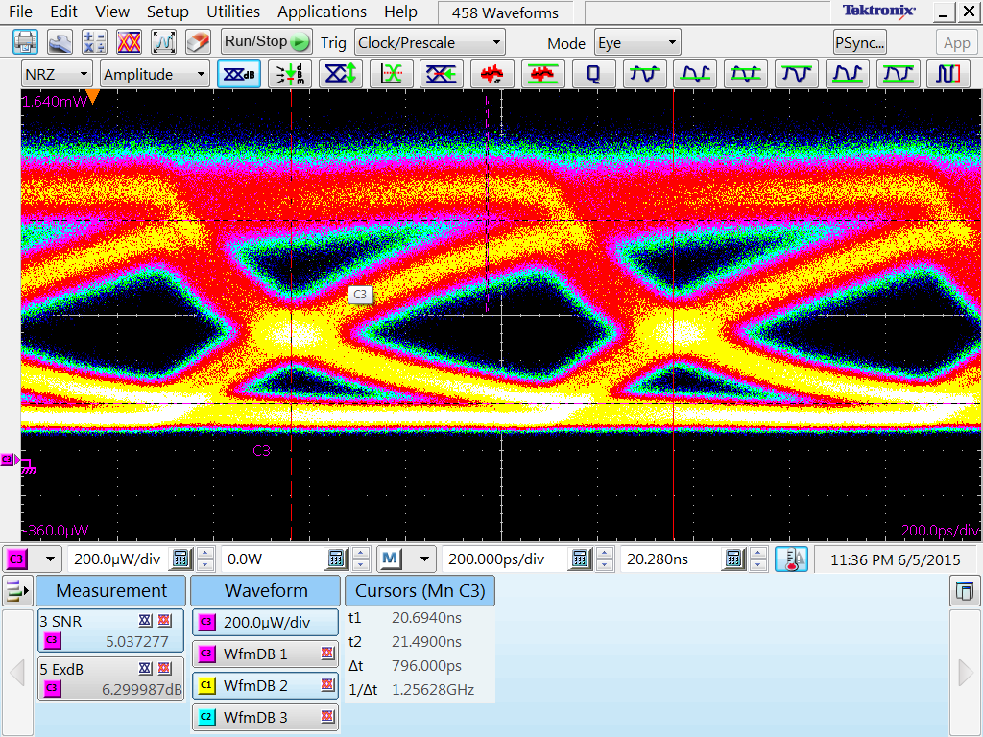
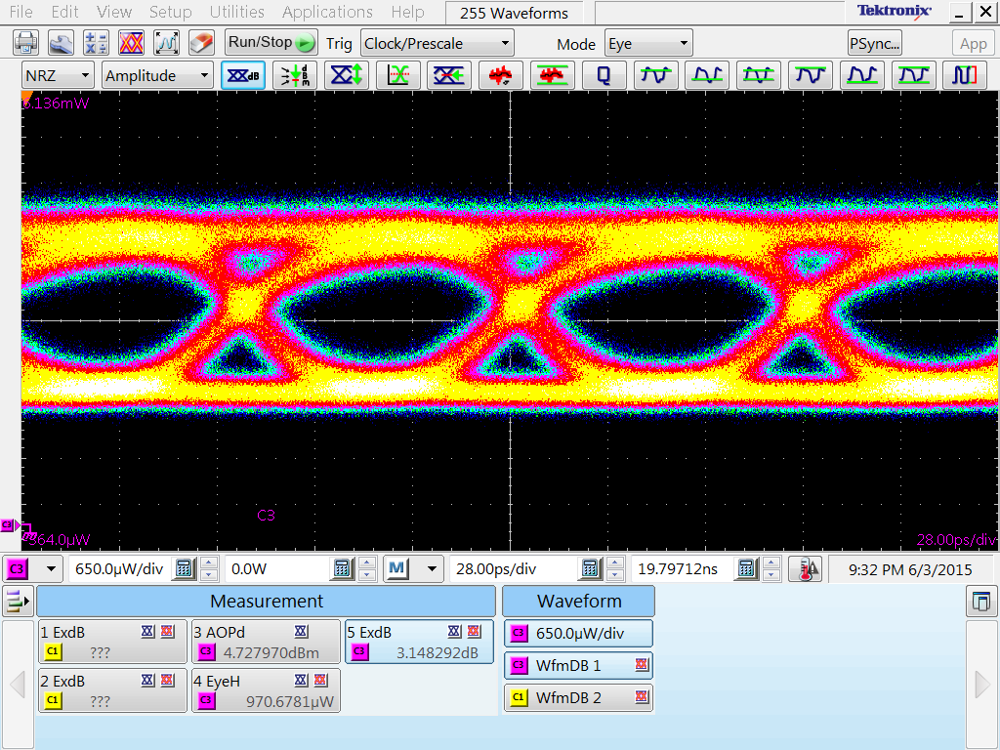
(a)
Exciton transitions absorption, @1550nm
(b)
Continuum transitions absorption, @1550nm
1.25Gbps, Vpp=50mV, Bias = 0.6V, ER = 6.3dB
12.5Gbps, Vpp=1.1V, Bias = -1.5V, ER = 3.1dB

Slide 13
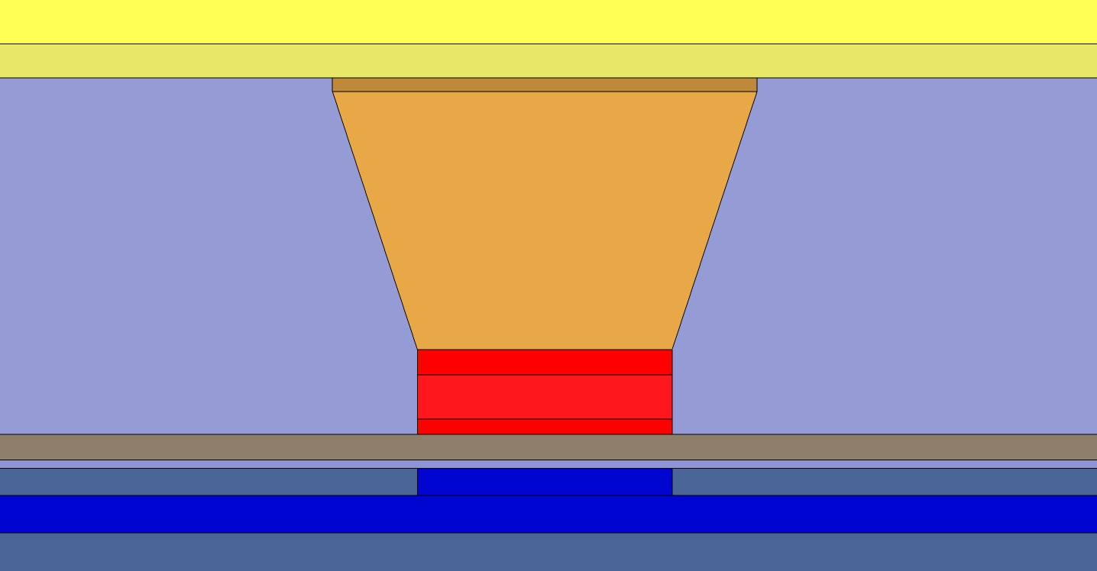
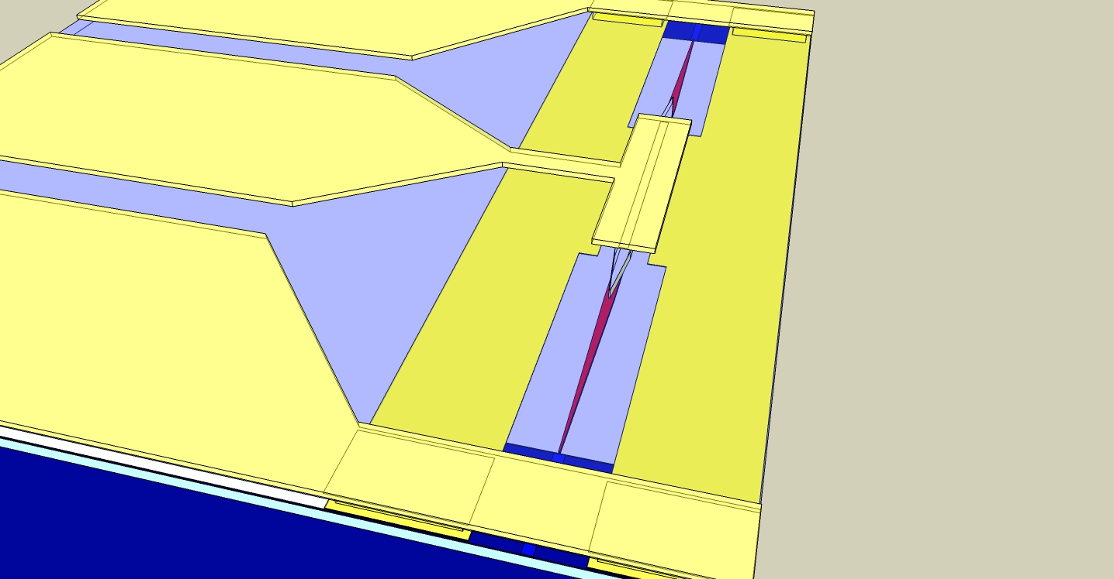
1 um Au
40 nmTi
0.1 μm p-InGaAs
1.5 μm p-InP
150 nm SCH
bi-level taper coupler
187 nm MQW
100 nm SCH
150 nm n-InP
380 nm Si
2 μm SiO₂

Slide 14
F<0
F=0
F>0
E_{F}
E_{e1}
E_{e1}
E_{e1}
E_{F}
E_{g}
E_{g}
E_{F}
E_{g}
E_{hh1}
E_{hh1}
E_{hh1}

